Slide 1
Proposal 3
The Basics
Camilla, Alex, Cameron

Slide 2
This Week’s Goals – Finalizing our first level
Background – Started
HUD – Still discussing
Troubleshoot our Ghost Enemy– Not Done
Begin working on Weapons, Bullets, etc. – Sprites Done! Stats still to come
Tilesets – Still Need To Do Some Research!
SFX – Done
Powerups
Potentially figuring out weapon drop percentages – Not quite there

Slide 3






Why Do These Changes Matter
They complete our first main goal! We hope to have at least have our level design and background finished by next demo
They finally add playability and hopefully a win/lose condition
We can finally work on making this game rouge-like platformer.

Slide 4
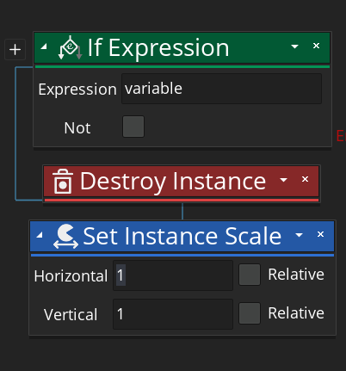
Icons
If Expression takes a variable and returns a Boolean based on the state of Boolean.
Destroy Instance completely removes an instance of an object
Set Instance Scale is used to scale sprites. We use it to change our sprites on a horizontal basis to flip the sprite.

